Slide 1

Your Brightpoint
Student Government Association
Officers
2025-2026

Slide 2
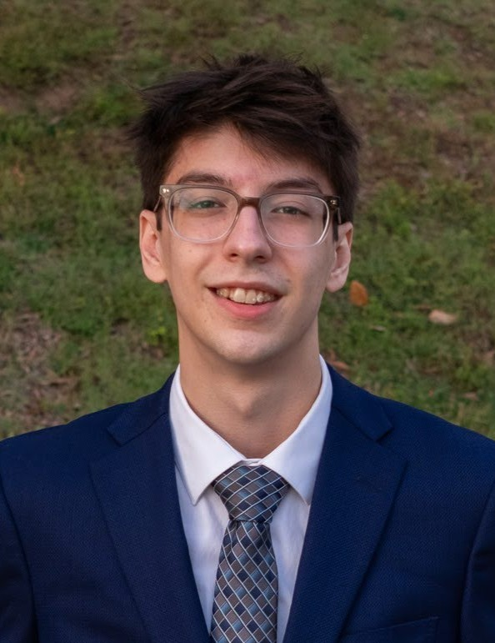
Aidan Silversmith
President
I'm Aidan Silversmith, and I'm studying engineering here at Brightpoint! Outside of class, I love reading about history and more, and I am always working on something new, like 3D printing. My dream career is in aerospace, and I hope to pursue this by studying engineering at Virginia Tech.

Slide 3
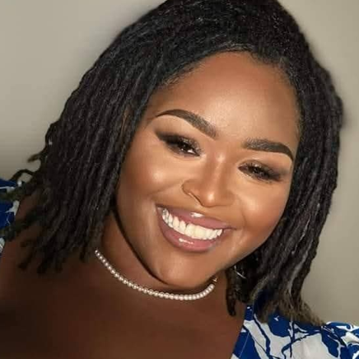
Marquita Stewart
Vice President
Hi, I’m Marquita Stewart ~Hawkins, Vice President of the SGA and a Human Services major. I’m a doula, and my goal is to become a therapist and open a wellness center for BIPOC and Queer individuals who need a safe space to heal. I love karaoke, traveling, crafting with my Cricut, and I’m fluent in American Sign Language (ASL).

Slide 4
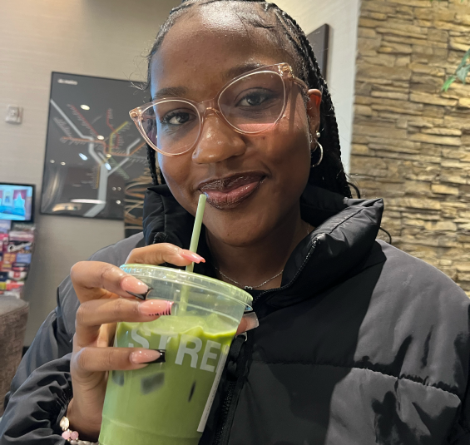
Taylor Parson
Secretary
My name is Taylor Parson, and I’m a Health Science major with plans to transfer to a four-year university and major in Biology. I love staying involved on campus, and meeting new people. When I’m not studying or working, you can probably find me volunteering, listening to music, or trying new food spots with friends. I’m excited to serve as Secretary and help create a student government that feels approachable and active.

Slide 5
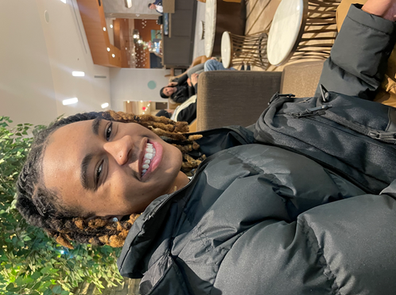
Jahmir Ewing
Treasurer
My name is Jahmir Ewing and I am a second year majoring in Business Administration. I have plans to transfer out of Brightpoint into a four year majoring in Accounting and have a goal of becoming a Certified Public Accountant. I am the President of the Black Student Alliance, and Vice- President of the Business Club as well. Some hobbies I have are going to the gym, boxing, and trying out new restaurants. I look forward to meeting everyone!

